Slide 1
Age of Reason (1750-1800)
Revolutionary Writers

Slide 2
Historical Context
Writers tried to tell men not to look to deity so much but to reason
American Revolution and the British influenced this period
Military victory strengthened nationalistic hopes for new literature
Writers had genuine patriotism but were self conscious

Slide 3
Historical Context (cont.)
These writers were born in England and raised in England, so there was some literary imitation
Writing at this time did not pay; there were no modern publishers, no audience, no adequate legal protection
A good deal of pirating of great European books occurred (Franklin started it; others followed)
The copyright law of 1790 protected American writers only and allowed pirating

Slide 4
Genre/Style
Political pamphlets, essays, travel writing, speeches, documents
Instructive in values, highly ornate (decorative/elaborate) writing style

Slide 5
Major Writers
Major Writers

Slide 6
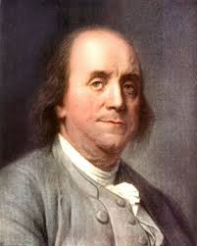
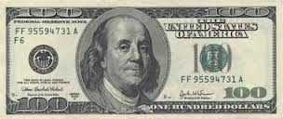
Benjamin Franklin (1706-1790)
Writer, printer, publisher, scientist, philanthropist, diplomat
Most famous and respected private figure of his time
First great self-made man; second-generation immigrant
Taught himself languages, read widely

Slide 7
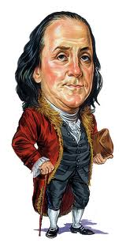
Benjamin Franklin
Well known for his aphorisms (a statement or saying that is both efficiently presented and either witty or wise.)
“Haste makes waste”
“Early to bed, early to rise, makes a person healthy, wealthy and wise”
“A small leak will sink a great ship”
Despite his prosperity and fame, he never lost his democratic sensibility
Major works
Autobiography
Poor Richard’s Almanac

Slide 8
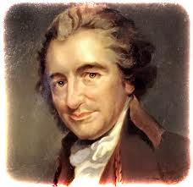
Thomas Paine
(1737-1809)
Inspired the Declaration of Independence
Read aloud in public to excite the audiences
Soldiers read them in camps/trenches
Major works
“Common Sense” (over 100,000 copies made)
“The American Crisis”

Slide 9
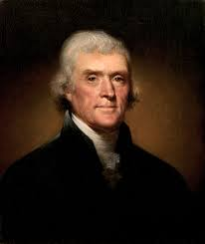
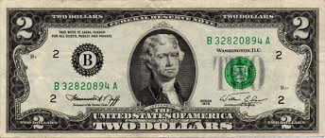
Thomas Jefferson (1743-1826)
Considered the finest writer of the era
Major work: Declaration of Independence

Slide 10
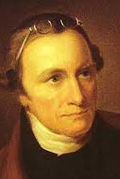
Patrick Henry(1736-1799)
A fiery orator and voice or protest
Major works include “Speech in the Virginia Convention”

Slide 11
