Slide 1
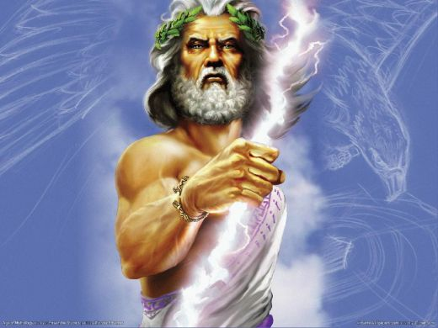
Allusions English III

Slide 2
Once in a Blue Moon
The second full moon within the same calendar month
Occurs every three years
Refers to something that occurs very rarely

Slide 3
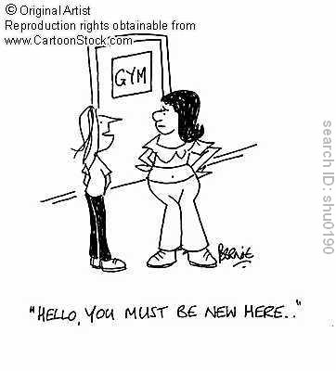
Left Handed Compliment
In language and history, the left hand is usually negative
Left handed compliment refers to a compliment that is rude or insulting

Slide 4
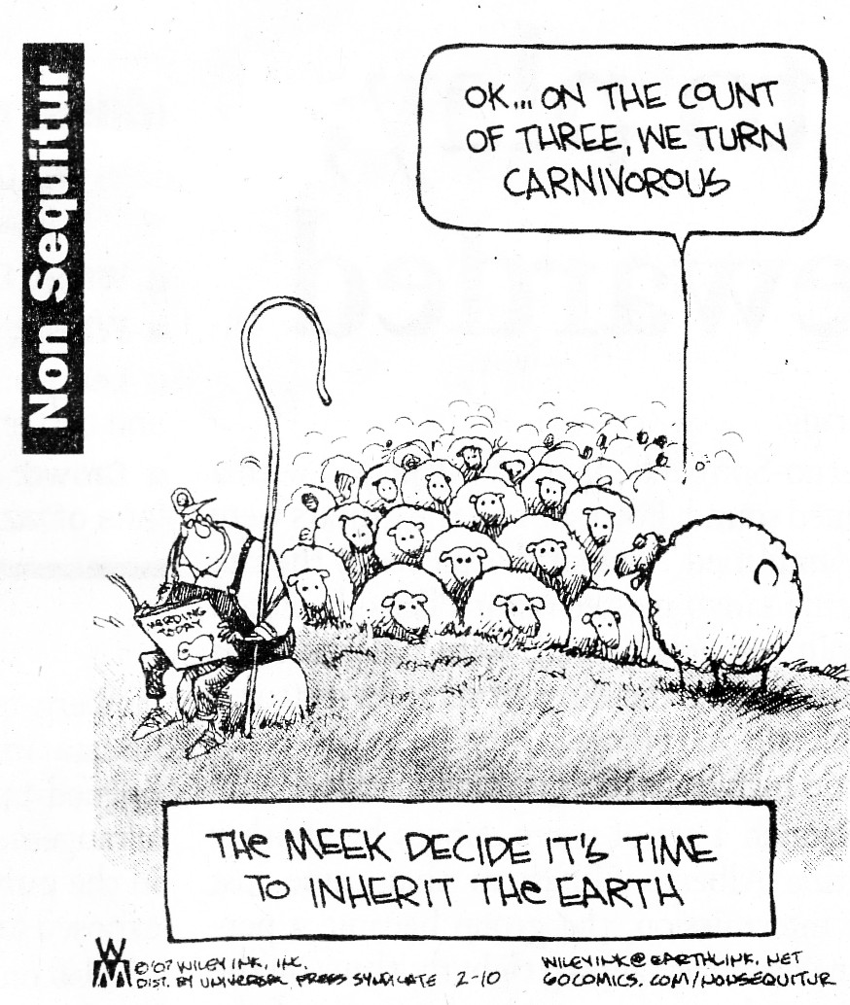
Non Sequitur
The Latin translation means “does not follow”
A phrase that is generally unrelated to what has been said before or a conclusion that does not logically follow from the premise

Slide 5
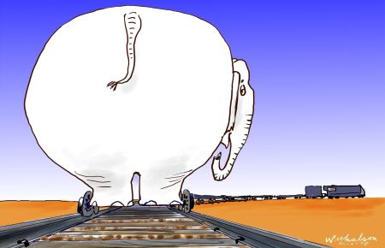
White Elephant
Due to their rarity white elephants are not subject to toil or work
Because of this white elephants become a huge financial burden
This is why a white elephant refers to a gift meant to be a financial burden or inconvenience

Slide 6
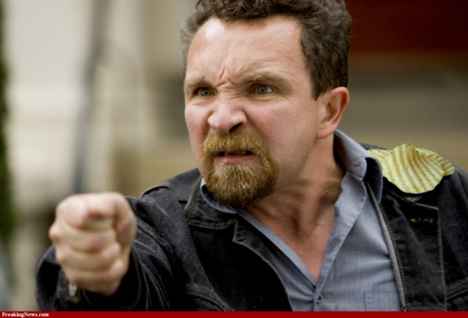
A Chip on One’s Shoulder
A person who is inclined to be resentful or someone who seems to be looking for a fight
This originated from “the old days” when boys would place a piece of wood on their shoulders and dare some one to knock it off.

Slide 7
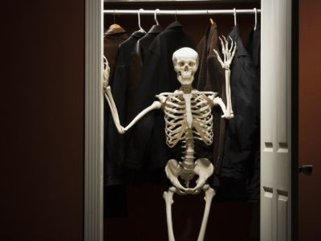
Skeleton in the Closet
An embarrassing thing about a person that that person would prefer to keep hidden or secret

Slide 8
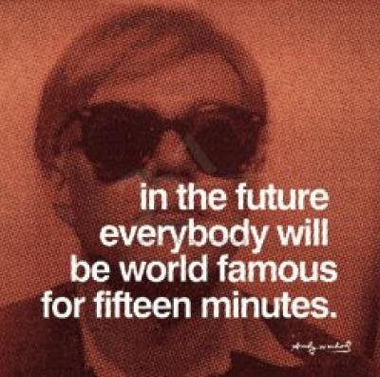
Fifteen Minutes of Fame
When a person receives a great deal of media attention over something trivial
Phrase was coined by Andy Warhol

Slide 9
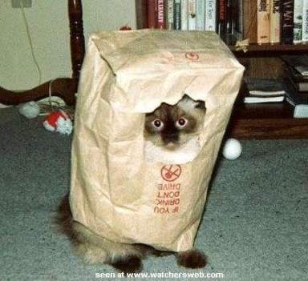
Let the Cat out of the Bag/ Buy a Pig in a Poke
From medieval times when farmers would take a pig to market in a bag (called a poke) but instead would place a cat inside to swindle the buyer. Some bought without checking the bag, and wound up with a cat; this is referred to as buying a pig in a poke.
Those who did check the bag obviously let the cat out of the bag.

Slide 10
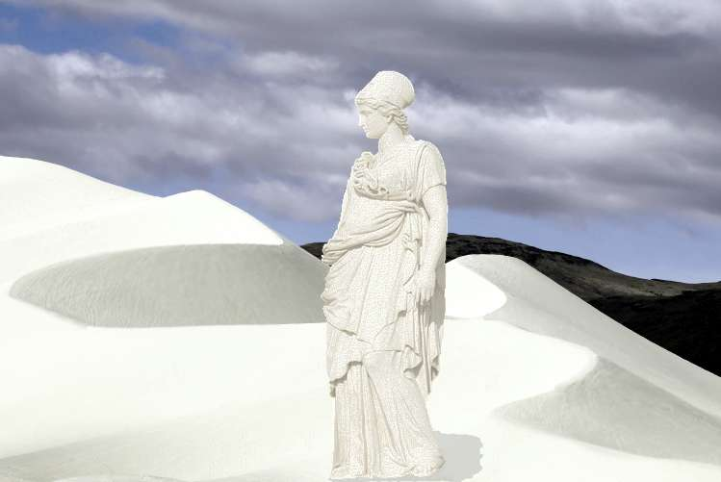
Lot’s Wife/ Pillar of Salt
From the Book of Genesis where God destroyed the cities of Sodom and Gomorrah
Lot’s wife looked back as the cities were being destroyed and was turned into salt
Refers to someone who unwisely looks back or deliberately disobeys a command

Slide 11
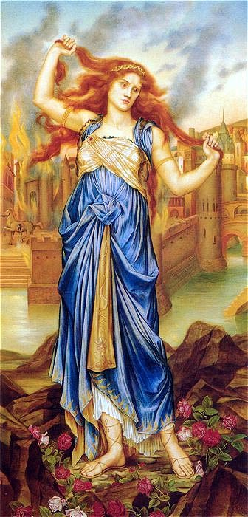
Cassandra
The daughter of a Trojan king whose prophecies were true but not believed which led the Trojans to disaster
Today it refers to someone who predicts disasters but is generally disregarded

Slide 12
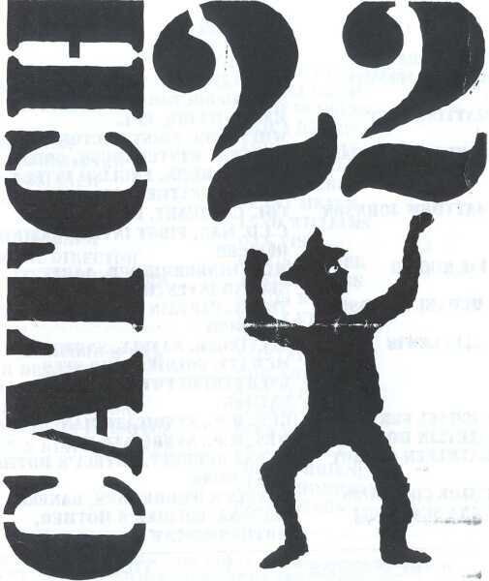
Catch 22
Originates from a novel by Joseph Heller
Has come to mean an absurd, no-win situation

Slide 13
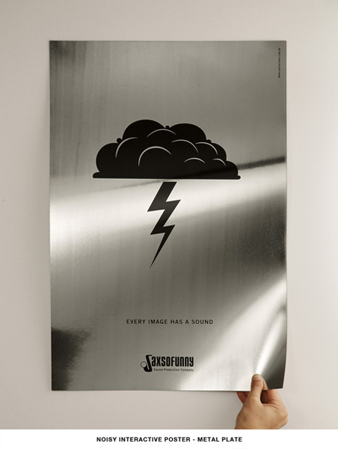
“Steal My Thunder”
To “steal someone’s thunder” is either to take credit for the idea of another or the lessen the effect of another’s idea by suggesting the same idea first.
Originated when a new playwright/director made the thunder sound with a sheet of metal in his play, which would up being a failure. Failure or not, other directors copied this method, “stealing his thunder”.

Slide 14
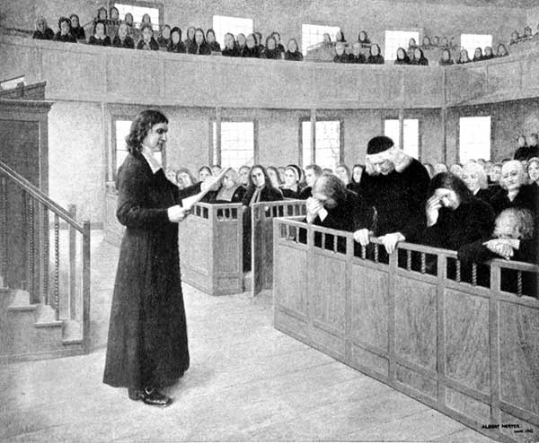
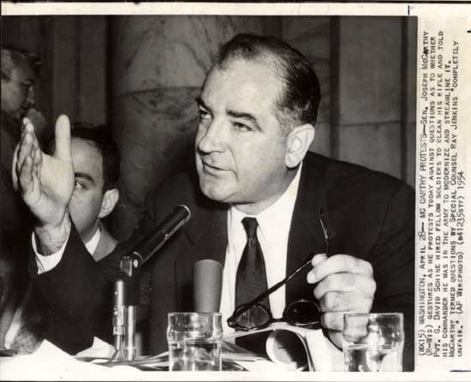
“Witch Hunt” Refers to a campaign against a particular group of people, often those holding unorthodox opinions or behaving in an unconventional manner

Slide 15
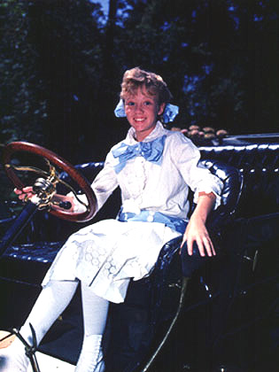
“Pollyanna”
“Pollyanna” has come to refer to someone who is unusually optimistic & always looking at the bright side. The term often has connotations of being excessively cheerful & naïve.
Originated from the children’s stories, where the character made the Glad Game, the object being to be super happy and say nice things.

Slide 16
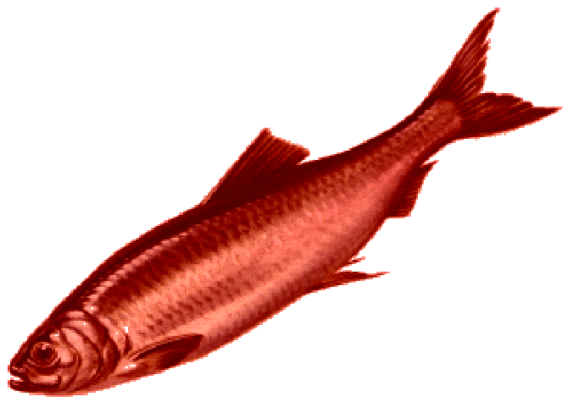
RED HERRING
“Red Herring” refers to diverting someone onto a false trail or distracting a person from the true issue.

Slide 17
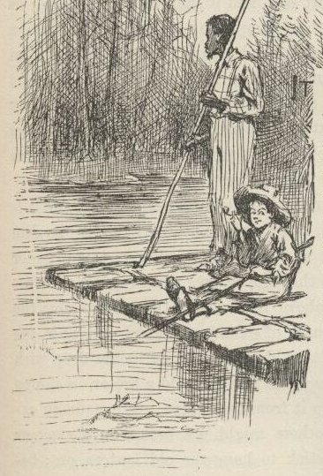
Sold Down the River
r
To be “sold down the river” is to be betrayed
or misled, especially by someone trusted.

Slide 18
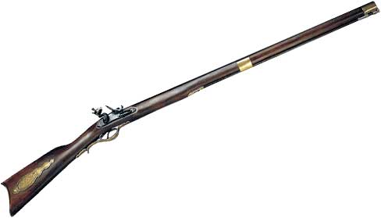
Flash in the Pan -Flintlock rifles had an ignition pan containing gunpowder. If the powder in the pan lit but the propelling charge was not lit, there was a flash in the pan, but the gun did not fire…
Flash in the Pan is something or someone that initially shows great promise but soon fails to meet expectations.

Slide 19
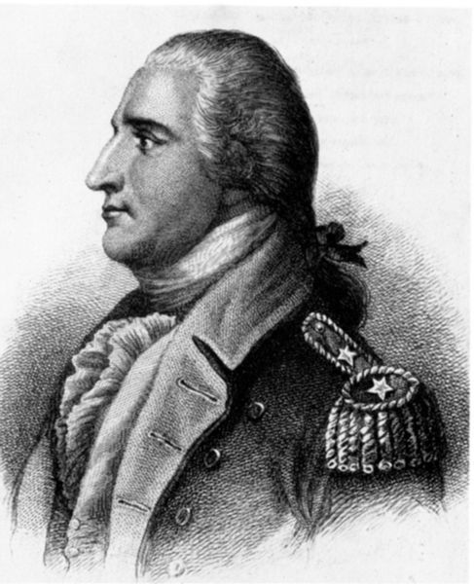
Benedict Arnold
A military leader during the American Revolution but turned traitor
Now the term is synonymous with traitor

Slide 20
Over a Barrel
In the past, someone was draped over a barrel after being rescued from drowning so their lungs would drain
Now refers to someone who is completely depending on some one else

Slide 21
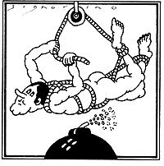
Hoist with one’s own petard
A weapon in medieval warfare that, if it exploded prematurely, would blow up its user.
The phrase refers to being caught in one’s own trap or being beaten at one’s own game.

Slide 22
Coals to Newcastle
A coal mining city in northern England
Therefore shipping coals to Newcastle would be superfluous
This gives rise to the term coals to Newcastle which means giving a superfluous gift or a contribution that is gratuitous and unnecessary

Slide 23
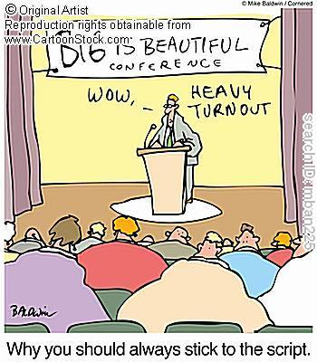
Freudian Slip
Sigmund Freud was an Austrian physician and psychotherapist
The phrase refers to an accidental in speech or action that reveals ones inner thoughts

Slide 24
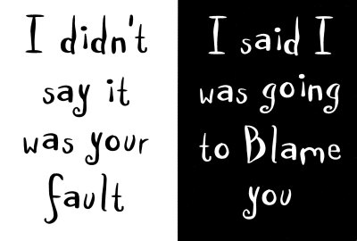
Pass the Buck
In poker, a “buck” is a marker that is passed to the person whose turn it is to deal
It refers to a shift in responsibility (and often blame) to another person

Slide 25
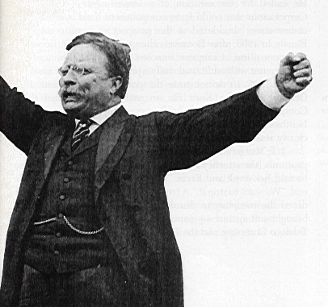
Muckrakers
Under President Roosevelt’s term the nation focused on “muckraking” or cleaning up corruption
The term is applied to authors or journalists who expose corruption

Slide 26
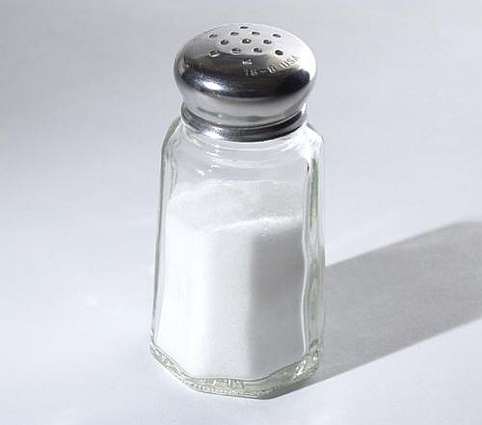
Sine qua non
In Latin, the phrase means “without which, nothing”
Refers to the essential ingredient without which something would be impossible

