Slide 1
The Crucible, Arthur Miller, & McCarthyism

Slide 2
Arthur Miller: A Life
Born on October 17, 1915
Attended the University of Michigan from 1934-1938
Graduated with a degree in journalism
Wrote and produced five plays during college career
Married three times

Slide 3
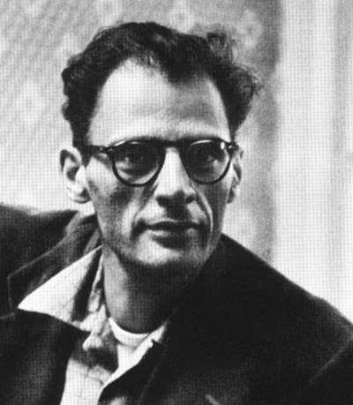
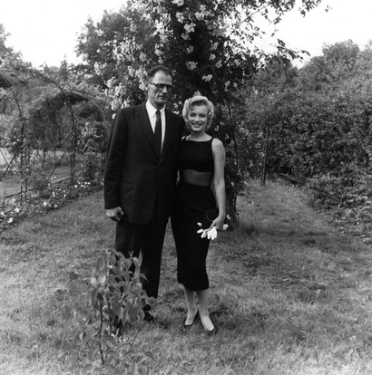
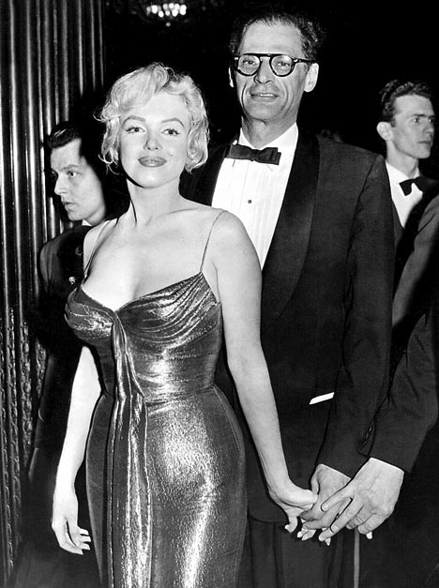
Being a talented writer can have some serious perks…

Slide 4
Why did Miller write this???
The Crucible is an allegorical response to the “red scare” communist hunts in the 1950s
A result of the Cold War and fears of a nuclear attack from Russia
Politicians sought out those who were possible COMMUNISTS

Slide 5
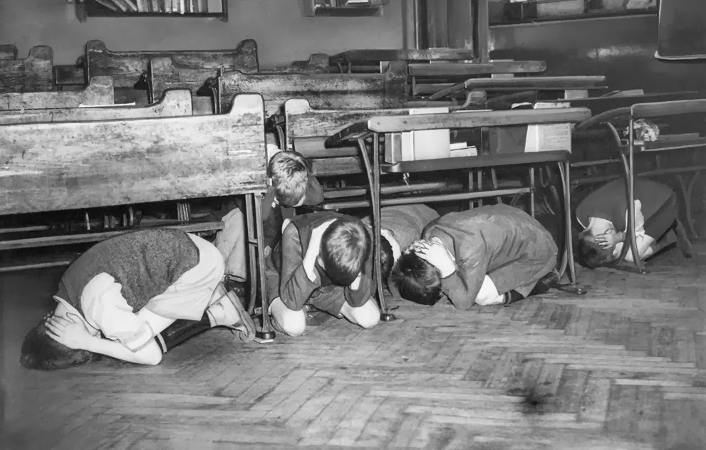
Here’s how it began…
It was leaked that the Russians had the recipe for the atom bomb.
People began to panic…THE RUSSIANS WERE OUT TO GET US!
Hysteria
Bomb drills
Suspicion…which led to accusations

Slide 6
The Red Scare
Many government officials were involved or accused…you were either a patriot, hunting out the commies, or you were a communist spy and needed to be jailed
Many writers, actors, and directors lost their jobs
Reputations were shattered
Many named names to save their own careers

Slide 7
Who led the “Red Scare?”
Senator Joseph McCarthy
Created a list of those who he believed were communist
Had the HUAC investigate those on the list and call them in for trial
“McCarthyism”

Slide 8
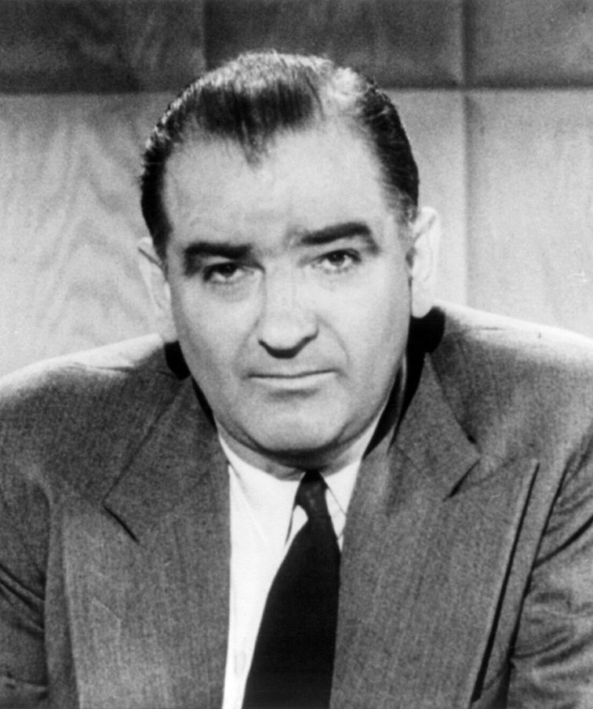
Senator Joseph McCarthy

Slide 9
Miller and HUAC
Investigated for possible associations with the Communist party from 1953 to 1955
In 1956, he was called to testify before the House Committee on Un-American Activities (HUAC).
Only attended meetings looking to advocate social justice and equality
When brought before the committee, he refused to name any other attendees.

Slide 10
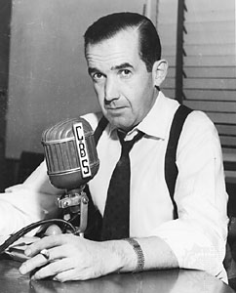
“Good Night, and Good Luck”
Highlights the struggles between Edward R. Murrow and Joseph McCarthy
Murrow had a nightly talk show, See it Now, and asked McCarthy to do a guest appearance to ask him his motives in his modern day “witch-hunts”
McCarthy finally made an appearance AND….

Slide 11
Murrow brought many of McCarthy’s Flaws into the Light
This is a quote taken from Murrow’s transcript from that evening….
“The actions of the junior Senator from Wisconsin have caused alarm and dismay amongst our allies abroad, and given considerable comfort to our enemies. And whose fault is that? Not really his. He didn't create this situation of fear; he merely exploited it -- and rather successfully. Cassius was right. "The fault, dear Brutus, is not in our stars, but in ourselves.“
Good night, and good luck.”

Slide 12
Miller’s Purpose
Miller wrote The Crucible in 1953, at the height of the Red Scare.
He wanted to highlight the parallels between the unjust Salem Witch Trials and the McCarthy/Communist trials in order to make a powerful statement about the dangers of mass hysteria.

Slide 13
So…What happened in Salem?
1692 Salem, Massachusetts
A strict Puritan community (in other words, a theocracy)
Accusations of witchcraft led to 20 executions
Over 10 others died in prison while waiting for trial

Slide 14
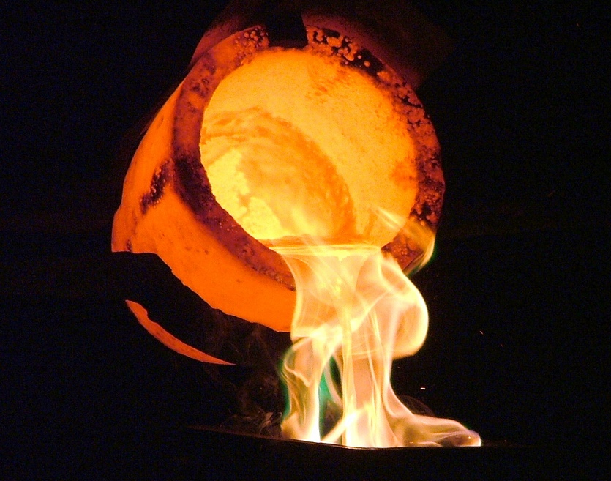
Why “The Crucible” ???
A crucible is a vessel in which metals are heated to extremely high temperatures, melted down and purified. The play, The Crucible, shows a community that ignites and burns with accusations of witchcraft, mass hysteria, and retribution.

