Slide 1
Romanticism and Transcendentalism
English III

Slide 2
Journal Warm-Up
Consider the following quote by Friedrich Nietzsche:
“The individual has always had to struggle to keep from being overwhelmed by the tribe. If you try it, you will be lonely often, and sometimes frightened. But no price is too high to pay for the privilege of owning yourself.”
What do you think Nietzsche means by “owning yourself”? Do you feel like you own yourself, or do you feel like you are more often “overwhelmed by the tribe”? Give one example of a way that you feel pressured to conform to other people’s expectations or ideas of how you should act, look, talk, etc.

Slide 3
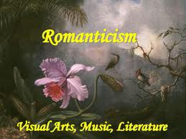
Romanticism (1800-1860)
A complete artistic, literary and intellectual movement that originated in the second half of the 18th century in Europe

Slide 4
Historical Context
Expansion of book publishing, magazines and newspapers
Movement gained strength in reaction to the Industrial Revolution
Echoed people’s fears, hopes, and aspirations
Abolitionist movement
Romantic poets invoked images of slavery in order to bring the issue closer to the minds of the English people, making them think less about an evil and morally wrong institution, but more about the different ways the system fostered those evils.
Though Romantic poets did not often come out directly in favor of abolition, the topic, issue, and discussion of slavery underscored much of their writing.
Romantic poems invite—often force—the audience to look upon the the individual slave, and then question what that slave’s relation is to the reader, and how the two are similar.

Slide 5
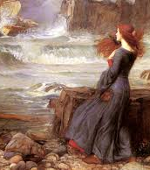
Genre/Style
Short stories, novels, and poetry
Focus:
imagination over reason
intuition over fact
the individual
the fantastic human experience
inner feelings
senses
Self and nature were one
Self-awareness

Slide 6
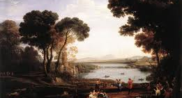
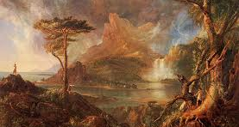
Romanticism emphasized a love of nature
Remember Neoclassicism? Below is a neoclassical view of nature: ordered and controlled
Romantics, on the other hand, believed imagination and emotion were more important than reason and formal rules
Below is a romantic view of nature
Claude Lorraine, Landscape
Thomas Cole, A Wild Scene

Slide 7
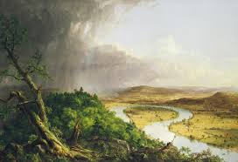
Romantics idealize country life and believe that many of the ills of society are a result of urbanization.

Slide 8
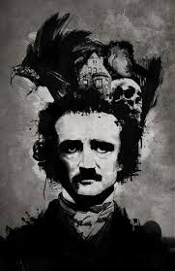
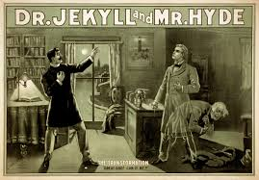
Gothic Literature
Sub-genre of Romanticism
Use of supernatural
Characters with both good and evil traits
Dark landscapes
Depressed characters

Slide 9
Major Writers
Nathaniel Hawthorne (1804-1864)
The Scarlet Letter
Edgar Allan Poe (1809-1849)
The Raven
Herman Melville (1819-1891)
Moby Dick
Harriet Beecher Stowe (1811-1896)
Uncle Tom’s Cabin

Slide 10
Transcendentalism

Slide 11
Traits of Transcendentalism
In some ways, a movement very similar to Romanticism
Transcendentalism also stressed the importance of individualism and drew inspiration from nature
The key difference is that Transcendentalism is more focused on religion, believing that a personal relationship with God was possible through intuition and self-discovery, not solely facilitated through the Church and other external institutions
The hero typically faced risk, or even destruction, in the pursuit of metaphysical self-discovery
Like the Romantics, Transcendentalists opposed slavery and were often active in the abolitionist movement

Slide 12
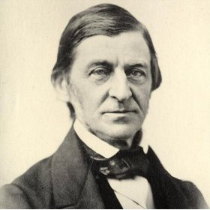
Transcendentalists
Ralph Waldo Emerson (1803-1882)
“Self-Reliance”
“Nature”
Henry David Thoreau (1817-1862)
Walden
“Civil Disobedience”
Walt Whitman (1819-1892)
Leaves of Grass
Emily Dickinson (1830-1886)
Collected Poems

Slide 13
Emerson Activity
Read the excerpt from “Self-Reliance” on page 190 of the textbook.
In contemporary society, many figures in popular culture echo Emerson’s famous motto “Trust thyself.”
With a partner, brainstorm a list of celebrities you are familiar with whose work or actions encourages nonconformity and individual self-expression.
Choose ONE person from your list of potential candidates to be your “Modern Day Emerson.” Come up with 2 specific examples (quotes, song lyrics, fashion style, actions, etc.) of how you think that person exemplifies Emerson’s philosophy of self-reliance.
Each pair will briefly present their “Modern Day Emerson” to the class and explain their 2 examples.

