Slide 1
Warm Up
What do you know about the Syrian refugee crisis?
Look up on your phone 3 facts about the refugee crisis.

Slide 2
Enlightenment
(1607-1800)

Slide 3
Two Phases
1. Pilgrims/religion (Age of Faith)
2. Patriots/politics (Age of Reason)

Slide 4
The Age of Faith
(1607-1750)

Slide 5
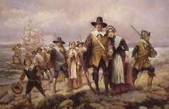
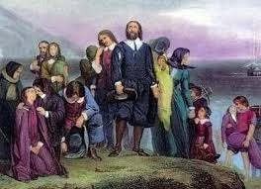
Pilgrims and Puritans
Pilgrims
Puritans
Who are they?
What do they have in common?
What is the difference between the pilgrims and the puritans?

Slide 6
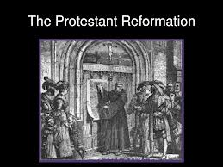
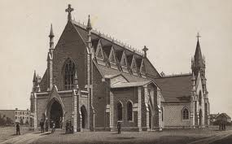
Pilgrims
Historical Context:
Products of the Reformation and Renaissance (end of the Middle Ages)
Separated from the Anglican church
Hence, they were known as separatists

Slide 7
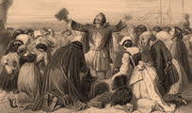
Historical Context:
Puritans came as official members of the the Church of England (Anglican Church)
Puritans were extreme reformists, seeking to bring the Church to a state of purity that would match Christianity

Slide 8
Which description fits for pilgrims? Puritans?
These people believed that they should separate themselves from the “corrupt” Church of England
These people believed that the Church of England needed reform

Slide 9
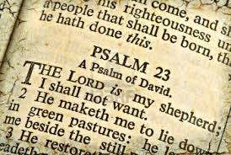
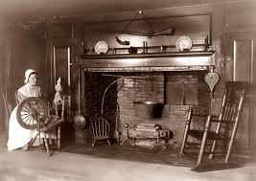
Puritans and Pilgrims
Historical Context:
Religion dominated their lives and writings
Everything was a message from God
Believed in hard work and simple no frills living
People of the book: read and re-read the Bible

Slide 10
Genre/Style
Sermon, diaries, letters, personal narratives, slave narratives, poetry
Once explorers began to travel to the New World, they chronicled their experiences in the form of diaries and letters home.
Often, the diaries and letters were propaganda designed to increase settlers’ interest in the land.
Instructive
Plain style (used everyday language)

Slide 11
MAJOR WRITERS
The Age of Faith

Slide 12
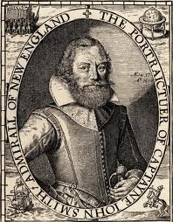
John Smith (1580-1631)
Founded Jamestown in 1607
Described the country as paradise (what everyone was looking for)
Known as an adventurer; a writer; difficult
Somewhat of a braggart

Slide 13
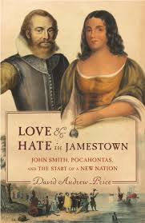
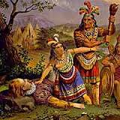
John Smith (cont.)
Major Works:
“General History of Virginia”
Pocahontas Legend

Slide 14
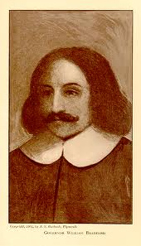
William Bradford (1590-1657)
Gave the group the name of pilgrims
Intended to land in Virginia, but landed on the tip of Cape Cod (now Massachusetts) in the winter of 1620
As they were about to land the ship, Bradford’s wife jumped overboard and drowned

Slide 15
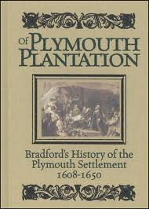
William Bradford (cont.)
Part of writing the Mayflower compact
Elected governor of Plymouth (re-elected 30 times)
Major works include “Of Plymouth Plantation”

Slide 16
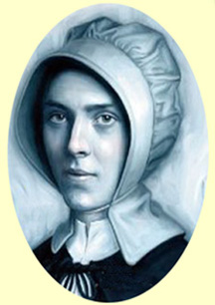
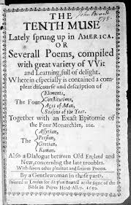
Anne Bradstreet (1612-1672)
First published American poet (not another poet for 200 years)
Used conceits (or extended metaphors)
Modest and somewhat embarrassed
Brother-in-law (John Woodridge) took verses copied for family and published them in 1650 under the title The Tenth Muse Lately Sprung Up in America

Slide 17
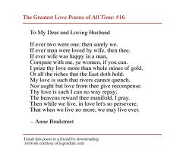
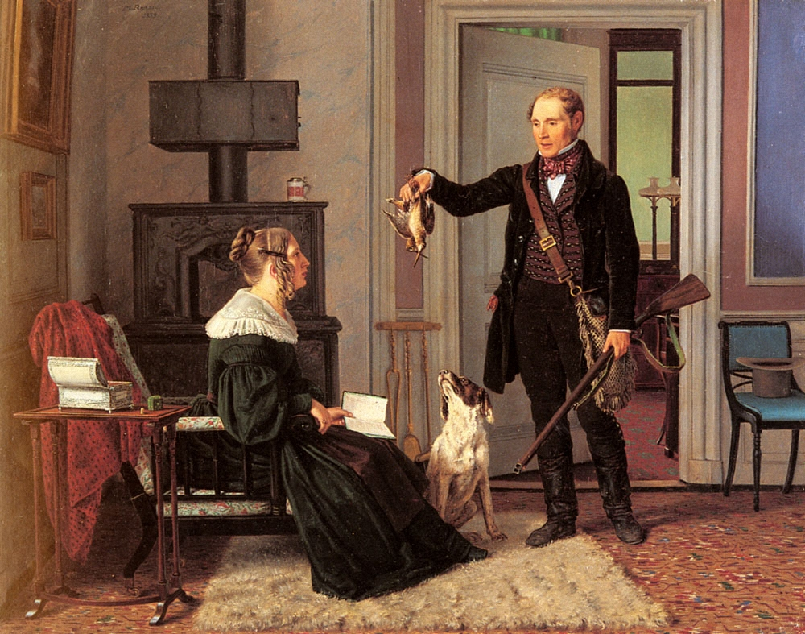
Anne Bradstreet (cont.)
Major Works:
“To My Dear and Loving Husband”
“Upon the Burning of Our House”
“The Flesh and the Spirit”
“The Author to Her Book”

Slide 18
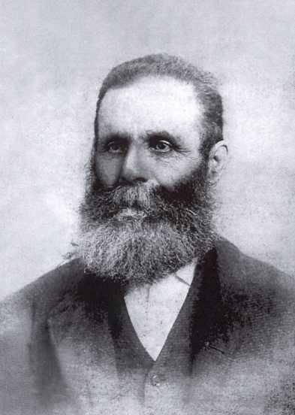
Edward Taylor (1644-1729)
Clergyman/minister
Poems unheard of until 1930 when discovered in Yale library
Wrote conceits in the style of metaphysical poetry (abstract/supernatural)

Slide 19
Edward Taylor (cont.)
Examined inner self-commune with God (these meditations helped him prepare for sermons)
He asked for help from God to glorify God
Major works
“Huswifery”
“Upon a Spider Catching a Fly”

Slide 20
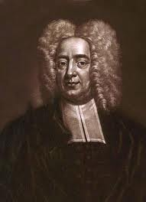
Cotton Mather (1663-1728)
Lectured classmates on their sins
Had 15 children; only two survived
Two wives died
Last wife went insane
Unceasing writer with over 500 books and pamphlets
Major works:
“Magnalia Christi Americana”
“The Wonders of the Invisible World”

Slide 21
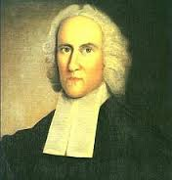
Jonathan Edwards (1703-1758)
Viewed God as punitive (wrathful) and distant
Viewed man as basically evil
Believed that he communicated directly with God
His sermons sent “whole congregations into hysterical fits of weeping”
Major works include “Sinners in the Hands of an Angry God”

Slide 22
After reading
Emotional appeals: use of sensory details to create vivid imagery
Go back and highlight all examples of sensory details.
Discuss purpose
Why do people consider Edwards an effective preacher?
What makes him an effective speaker?

Slide 23
“Sinners in the Hands of an Angry God”
Persuasive sermon with fiery descriptions of hell and eternal damnation
Purpose: his reason for preaching
Audience: his Puritan congregation
Context: the times in which the Puritans lived

Slide 24
What is “rhetoric”?
Plato: [Rhetoric] is the "art of enchanting the soul." (The art of winning the soul by discourse.)
Aristotle: Rhetoric is "the faculty of discovering in any particular case all of the available means of persuasion."
Francis Bacon: The duty and office of rhetoric is to apply reason to imagination for the better moving of the will.
George Campbell: "[Rhetoric] is that art or talent by which discourse is adapted to its end. The four ends of discourse are to enlighten the understanding, please the imagination, move the passion, and influence the will."
Philip Johnson: "Rhetoric is the art of framing an argument so that it can be appreciated by an audience."

Slide 25
