Slide 1
Neoclassicism
English III

Slide 2
Neoclassicism
View of man as a man of reason
Regarded man a limited creature whose understanding was adequate (satisfactory) to explore the infinite (immeasurable/vast world)
Overlaps with Age of Reason time period

Slide 3
Neoclassicism (continued)
The revival of Greek and Roman ideals of art and literature that occurred in Europe in the 18th century Enlightenment (Age of Reason)
Ideals include:
Respect for authority
Respect for tradition
Reason and order
Moderation (self-control)
Simplicity (straightforwardness/ plainness)

Slide 4
Famous Writers

Slide 5
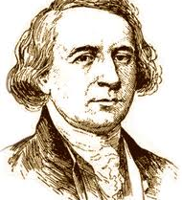
Philip Freneau (1752-1832)
“Father of poetry”
Incorporated varieties of European Romanticism (order, balance, decorum, moderation)
Embraced liberal and democratic causes
Revolutionary militiaman; captured by the British, almost died; stimulated words condemning (criticizing) cruelties of British

Slide 6
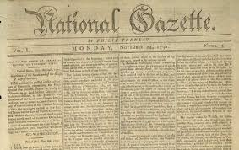
Philip Freneau (cont.)
Writing provided a good transition between neoclassicism and romanticism
Thomas Jefferson helped him establish the militant anti-Federalist National Gazette in 1791
Became the first powerful, crusading editor in America
Notes:
To Antifederalists the proposed Constitution threatened to lead the United States down an all-too-familiar road of political CORRUPTION. All three branches of the new central government threatened Antifederalists' traditional belief in the importance of restraining government power.

Slide 7
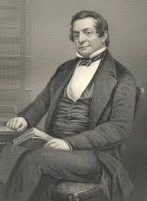
Washington Irving (1789-1859)
First American writer of imaginative literature to gain international fame
Took ideas from German literature
Witty, poor student, but well read
Youngest of 11 children in wealthy family
Took the satirical writing of 18th century and mocked/ridiculed the writings of his own time (typical of neoclassicism)

Slide 8
Washington Irving (cont.)
Early works displayed neoclassical pleasure in the comic qualities of life
His work reflected shift in American literature from rationalism to sentimental romanticism
Major Works
“The Legend of Sleepy Hollow”
“Rip Van Winkle”

Slide 9
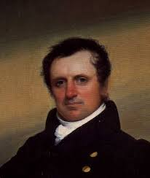
James Fenimore Cooper (1789-1851)
Never saw the frontier (border), yet his writing focused on this
Wrote sea novels
Created typical characters
Grew up in luxurious mansion; expelled from Yale; inherited money; went broke; began writing
Major Works
“The Leather Stocking Tales”
People dislike “The Leather Stocking Tales” (even still today)

Slide 10
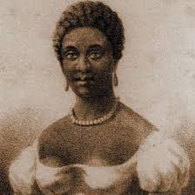
Phillis Wheatley (1753-1784)
Considered the first African-American writer of importance
Born in Africa; brought to America at 7; at 13 showed signs of a great poet
Material came from Bible and public events
Her works were used to prove that blacks were not inferior to whites

Slide 11
Phillis Wheatley (cont.)
Her work displayed characteristics of neoclassicism
Nicknamed “The Sable Muse” in London (translation: black poet)
Major Works
“To S.M., a Young African Painter on Seeing His Works”
“On Being Brought from Africa to America”

